Slide 1
National INJURY PREVENTION Week
November 13-17, 2023

Slide 2
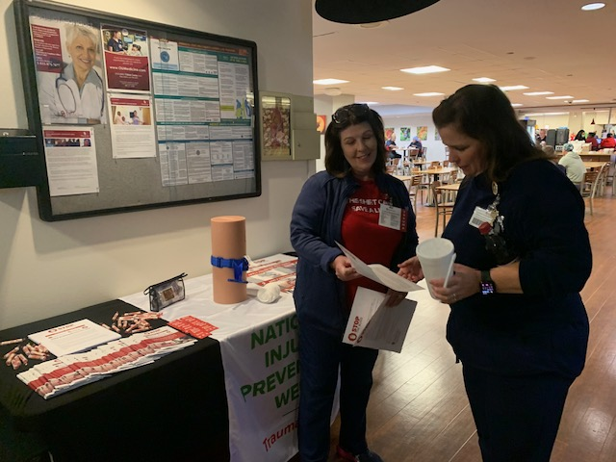
STOP the Bleed

Slide 3
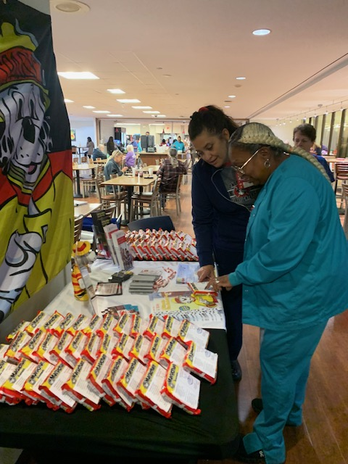
Burn Prevention

Slide 4
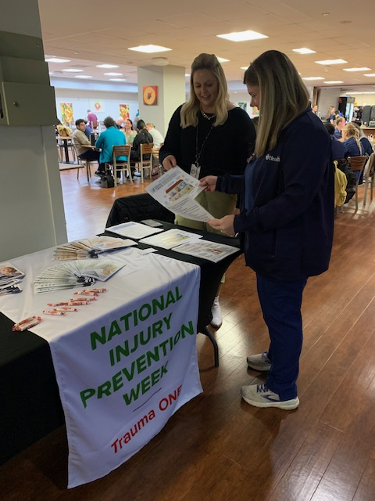
Older Adult Fall Prevention

Slide 5
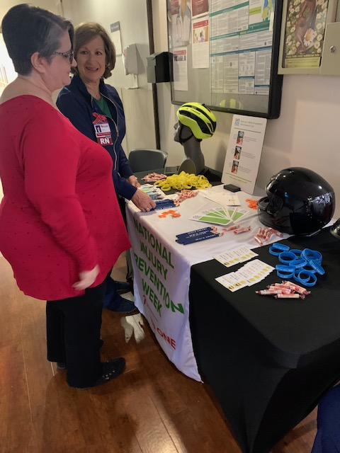
Bike and MCC Safety

Slide 6
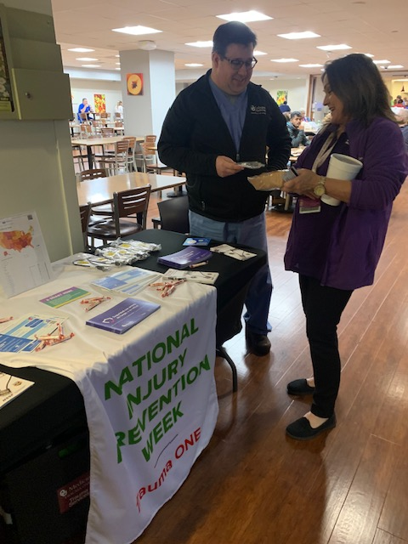
Firearm Safety

